Slide 1
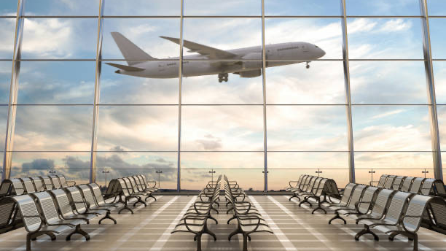
AIRLINE PROJECT

Slide 2
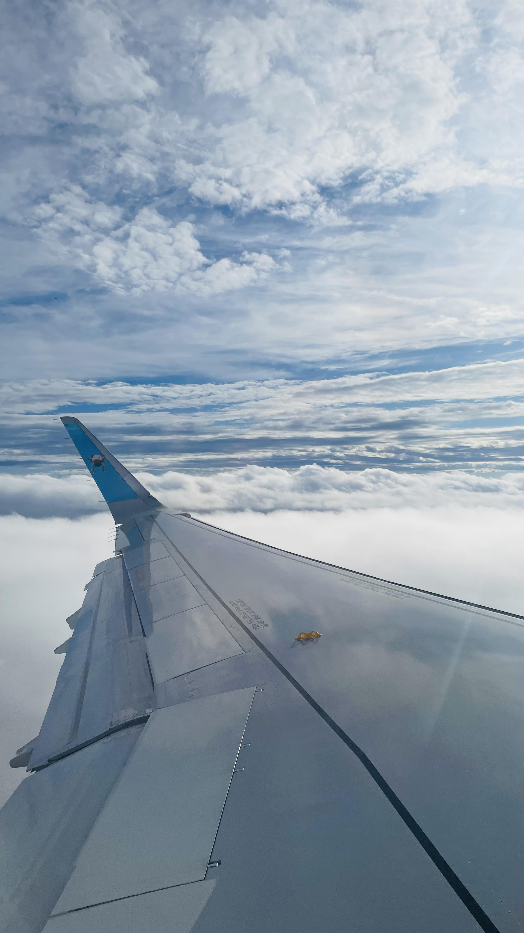
Soaring into the Heart of the U.S. Domestic Market
1. Initial Focus: 5 Round Trip Routes
Targeting medium and large U.S. airports to maximize reach and demand.
2. Investment in Fleet
Acquiring 5 new airplanes (one per round trip route).
Upfront Cost per Airplane - $90 million.
3. Brand Identity: “On Time, For You”
Punctuality as our core value and a key differentiator.

Slide 3
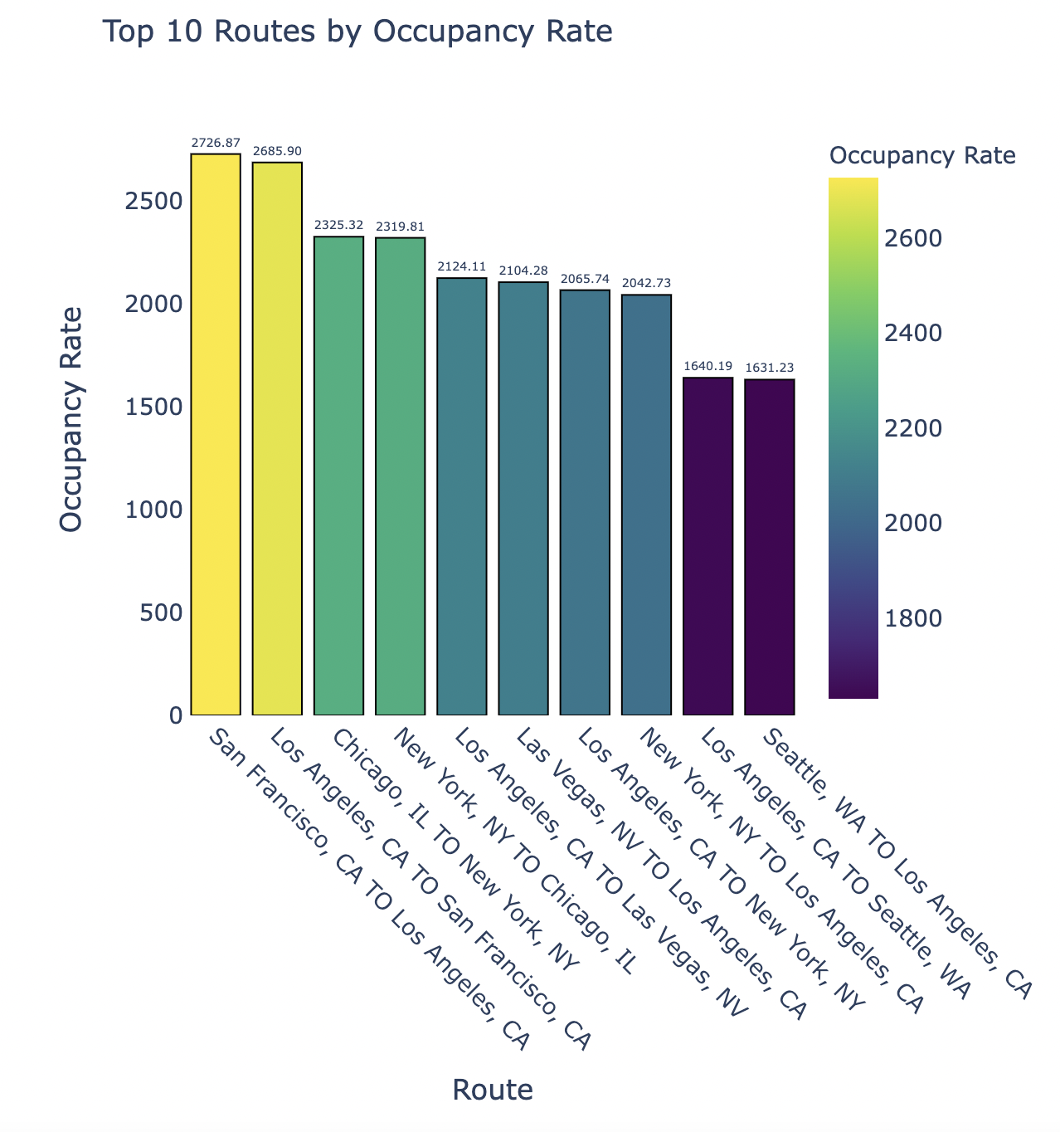
Identifying the busiest route

Slide 4
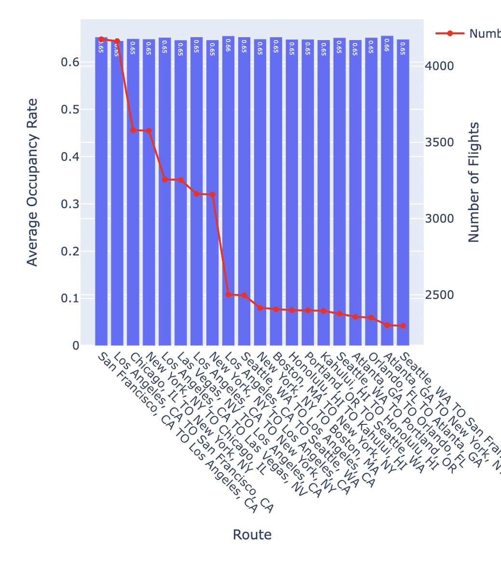

Slide 5
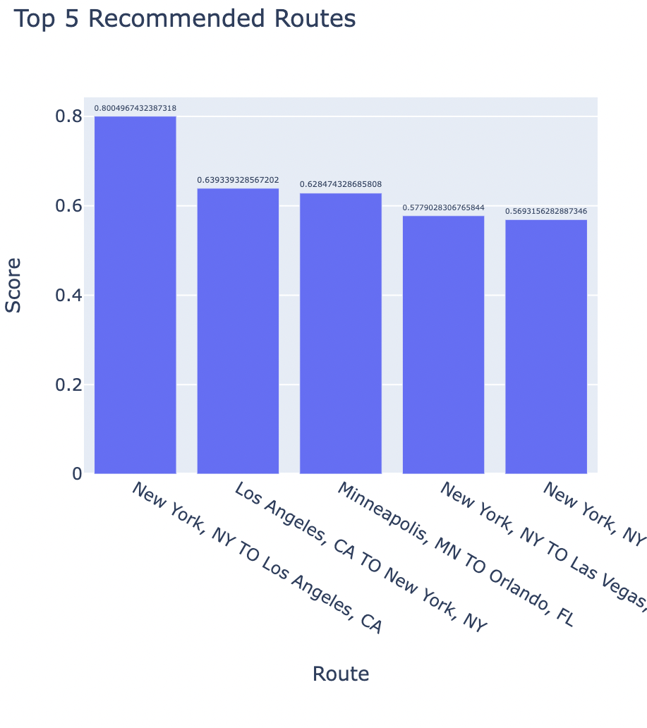

Slide 6
Recommendations!!!!
Running an analysis on the pricing of Economy, Basic Economy, and Business fares can help identify optimal ticket pricing strategies. By adjusting fares based on passenger demand and competition, we can attract more passengers while maximizing revenue across different fare classes.
Evaluating additional services such as meals, luxury products, drinks, travel perks, and discounts can enhance customer satisfaction and drive revenue. Tracking their adoption, costs, and impact on repeat business helps optimize profitability and loyalty.
Weather analysis enhances schedule reliability and passenger satisfaction.
Government Policies supporting tourism and business drive route expansion opportunities.
Tracking overall onboarding experience to can be one of the key parameter for customer satisfaction and customer to return for same flight experience for travelling.
These KPIs enable comprehensive analysis, supporting strategic decisions to optimize operations, revenue, and customer satisfaction in the airline industry.

